Slide 1
V M MEGA
generating music with RNN

Slide 2
generating music with RNN
PROJECT TITLE

Slide 3
agenda
to generate musical notes using a simple recurrent neural network (RNN).
train a model using a collection of piano MIDI files from the maestro dataset. Given a sequence of notes, your model will learn to predict the next note in the sequence.

Slide 4
PROBLEM STATEMENT
Our project aims to match input audio clips to similar video clips stored in a database. With this tool, artists can stitch together visuals from music videos or other visual sources to generate visual accompaniments for their music.
For technical evaluation, we planned to focus on both validation and training accuracy of our network.

Slide 5
PROJECT OVERVIEW
The objective of music generation is to explore deep learning regarding the field of music composition using artificial intelligence.
The case study focuses on generating music automatically using Recurrent Neural Networks(RNN).

Slide 6
WHO ARE THE END USERS?
Generative AI can help companies make better decisions. By using Generative AI, businesses can generate data that can be used to enhance data-driven decisions.
Generative AI can produce data that can be used to improve decisions about marketing campaigns or product development.

Slide 7
YOUR SOLUTION AND ITS VALUE PROPOSITION
Our project focuses on understanding and implementing AI techniques that facilitate music composition.
AI can make tunes by learning from a big collection of music pieces by using special math rules to understand patterns, beats, and structures in music and then making new tunes based on what it has learned.

Slide 8
THE WOW IN YOUR SOLUTION
The project not only generate the music based on commands, but also shows what kind of musical instruments are used.
For example :
Number of instruments : 1
Instrument name : Acoustic Grand Piano.

Slide 9
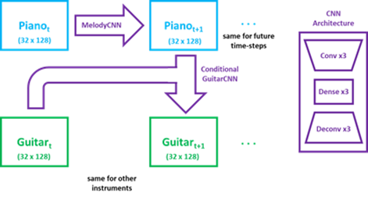
MODELLING

Slide 10
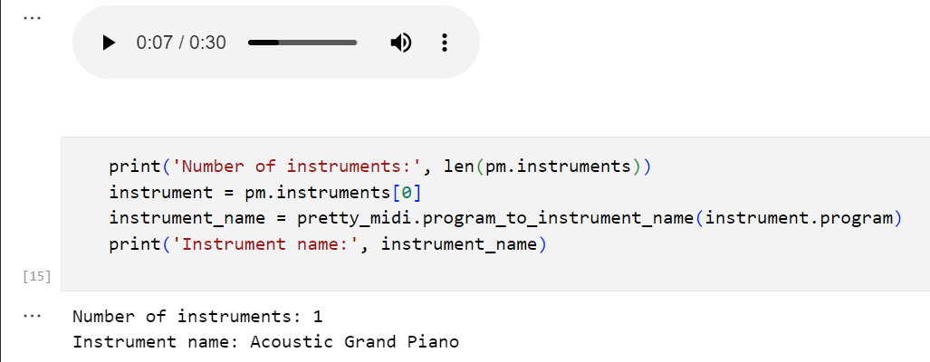
Results
The project shows the following Music Output

